Slide 1
Constrained Optimization
06th Oct. 2015

Slide 2
Constrained Optimization
So far we have discussed optimizing functions without placing restrictions upon the values that the independent variables can assume. Such problems are often referred to as free maxima and minima or free optima.
However, in the real world, often
restrictions or constraints
are placed upon values of the independent
variables.
These problems are referred to as
constrained optima or constrained optimization.

Slide 3

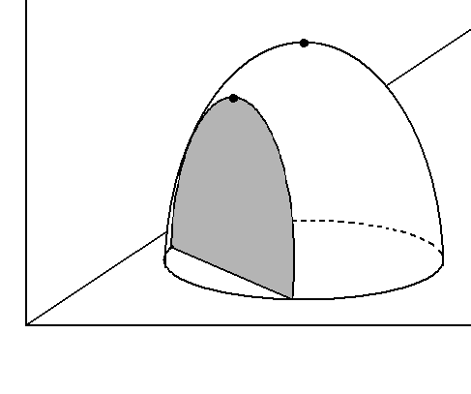
Constrained Optimization
Graphically, the difference between the free optima
and the constrained optima can be shown as:
Free
maximum
Constrained
maximum
constraint
06th Oct. 2015

Slide 4
Free
maximum
Constrained
maximum
constraint
The free optima occurs at the peak of the surface.
If we specify a specific relationship between variables and (a constraint) then the search for an optimum is restricted to a slice of the surface. The constrained maximum occurs at the peak of the slice.
06th Oct. 2015

Slide 5
Constrained Optimization
Since economists deal with the allocation of scarce resources among alternative uses, the concept of constraints or restrictions is important.
There are two approaches to solving constrained optima problems:
(i) substitution method
(ii) Lagrange multipliers
06th Oct. 2015

Slide 6


Substitution Method
Consider a firm producing commodity with the following production function:
Without any constraints, the firm can produce an unlimited quantity by utilizing an unlimited amount
of and .
06th Oct. 2015

Slide 7

Substitution Method
But suppose the firm has a budget constraint:
Let
For simplicity, assume that the maximum amount the firm can spend on these two inputs is $100.
So we have the following constraint:
p_{x1} = Rs. 2/unit
p_{x2} = Rs. 1/unit
06th Oct. 2015

Slide 8

Substitution Method
Suppose the economic question facing this firm is maximizing production subject to this budget constraint.
The solution via the substitution method is to substitute:
  First, write the constraint in terms of :
06th Oct. 2015

Slide 9



Substitution Method
  Then substitute this value into the production function, such that:
  With this substitution, the constrained maxima problem is reduced to a free maxima problem with one independent variable.
06th Oct. 2015

Slide 10



Substitution Method
  Now apply the usual optimization procedure:
  (critical value)
06th Oct. 2015

Slide 11


Substitution Method
  The method of substitution is one way to solve constrained optima problems. This is manageable in some cases. In others, the constraint may be very complicated and substitution becomes complex.
06th Oct. 2015

Slide 12



Lagrange Multipliers
The constrained optima problem can be stated as finding the extreme value of
subject to .
So Lagrange (a mathematician) formed the augmented function.
denotes augmented function
will behave like the function if the constraint is followed.
06th Oct. 2015

Slide 13
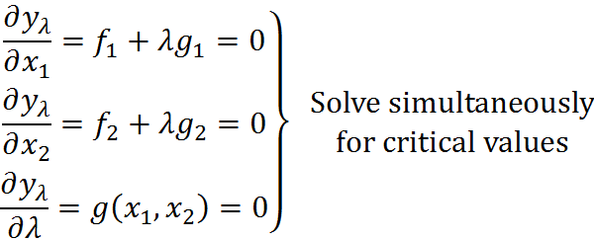
Lagrange Multipliers
Given the augmented function, the first order condition for optimization (where the independent variables are , and λ) is as follows:
06th Oct. 2015

Slide 14


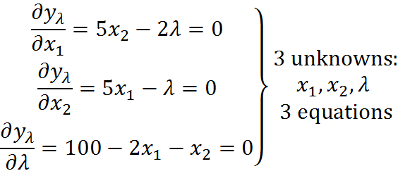
Lagrange Multipliers
Using the previous example:
note:
to be on the budget line
06th Oct. 2015

Slide 15



Lagrange Multipliers
Solving these 3 equations simultaneously:
06th Oct. 2015

Slide 16



Lagrange Multipliers
Solving these 3 equations simultaneously (cont’d):
06th Oct. 2015

Slide 17





Lagrange Multipliers
Solving these 3 equations simultaneously (cont’d):
06th Oct. 2015

Slide 18





Lagrange Multipliers
If , then
This solution yields the same answer as the substitution method, i.e., and .
06th Oct. 2015

Slide 19
Lagrange Multipliers
Economists prefer using the Lagrange technique over the substitution method, because:
easier to handle for most cases and
(ii) provides additional information.
Namely for (ii), the value of λ has an economic interpretation. (There is no counterpart to this variable in the substitution method).
06th Oct. 2015

Slide 20

Lagrange Multipliers
Given,
where C is the level of expenditures
(budget = $100 in this example).
here the Lagrange multiplier measures the
sensitivity of to changes in the constraint
(C ).
06th Oct. 2015

Slide 21




Lagrange Multipliers
2nd order conditions
Given
1st order conditions for extremum:
06th Oct. 2015

Slide 22
Lagrange Multipliers
2nd order conditions involve second order partial derivatives expressed in the form of a determinant.
In the constraint case, we will utilize the bordered Hessian – which is the Hessian of the free optima case surrounded by the partial derivatives with respect to the Lagrange multiplier λ.
06th Oct. 2015

Slide 23




Lagrange Multipliers
2nd order partials:
06th Oct. 2015

Slide 24





Lagrange Multipliers
2nd order partials:
06th Oct. 2015

Slide 25
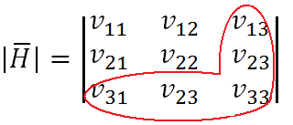
Lagrange Multipliers
Note: partials with respect to Lagrange
multiplier (λ) form the border
2 explanatory variables and 1 constraint is the largest size bordered Hessian we will consider for this class.
06th Oct. 2015

Slide 26


Lagrange Multipliers
So the 2nd order condition is:
Let’s now return to our previous example:
  Recall the critical values of ,
  and .
06th Oct. 2015

Slide 27



Lagrange Multipliers
What about the 2nd order conditions?
06th Oct. 2015

Slide 28
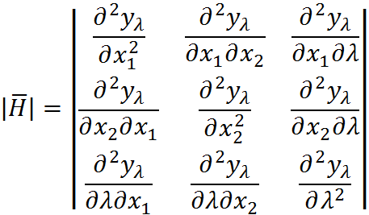
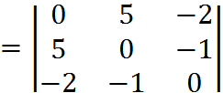

Lagrange Multipliers
Find
06th Oct. 2015

Slide 29




Lagrange Multipliers
Expand by 1st row:
06th Oct. 2015

Slide 30


Lagrange Multipliers
represents a relative max.
06th Oct. 2015

Slide 31
Assignment
100 m length of standard diameter of copper tube is to be fitted in cylindrical shell of a heat exchanger. As per the constraints of design 200 copper tubes can be accommodated in one square meter of cross section area inside the shell. Design the heat exchanger shell with an objective of minimizing the cost of the heat exchanger using following data:
Cost of copper tubes = Rs. 20000
Cost of heat exchanger shell = Rs. 60000D^{2.5}L
Cost of land = Rs. 10000 per square meter.
Where – D and L are diameter and length of heat exchanger in m respectively.
06th Oct. 2015

Slide 32
Key Equations
Objective Function
C = 20000+ 60000D^{2.5}L + 10000DL
Constraint – Φ = L-2/πD²
Lagrange Equation –
L.E. = (20000+ 60000D^{2.5}L + 10000DL ) + λ(= L-2/πD²)
06th Oct. 2015

